Slide 1
Using s3 and hdfs in combination
Data Lake/Warehouse/Sandbox
Notes:
[Mandatory Slide] This would be the introduction slide of the topic that you are covering in this subsection.
When this slide plays, you could talk about the main aim that we’d be covering in this video.

Slide 2
Storage Tiers
Storage Tier’ing uses two or more systems to store data.
This can be done for cost, performance, or backup purposes.
Notes:
This is a single point slide which can be used for multiple purposes.
Use 1 [Mandatory Slide]:
Before the start of the video, we’d like to highlight what are important topics or pointers that we’d be covering in this video. This slide would immediately follow the intro/name slide. This would just be say 2-3 points for the viewers to know what they are getting into.
Use 2:
This slide can also be used to cover topics that can be represented by an image/graph etc. Information which is half image/half information type. Like shown in the example above.

Slide 3
Potential use cases and benefits
Backup
Access to different technology
Sharing data across organizations
Controlling costs
Performance
Notes:
This slide, like mentioned above is for multiple pointers. The information above covers the types of information that can be used in this slide

Slide 4
Migrating data between
Step 3
Step 2
Discuss varying options
Step 1
Replicate dataset and schema as a backup
Define a dataset in a local HDFS storage
Notes:
This is a step-wise graphical info type slide.

Slide 5
Hadoop anatomy
<configuration> <property> <name>fs.default.name</name> …
hdfs
Hadoop-core
s3n
$ bin/hadoop dfs –put a /hdfs/stuff
Notes:
This slide, like mentioned above is for multiple pointers. The information above covers the types of information that can be used in this slide

Slide 6
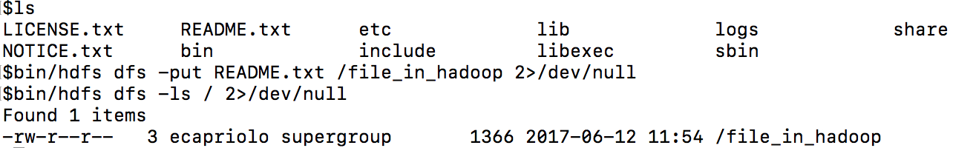
Basic hadoop put

Slide 7
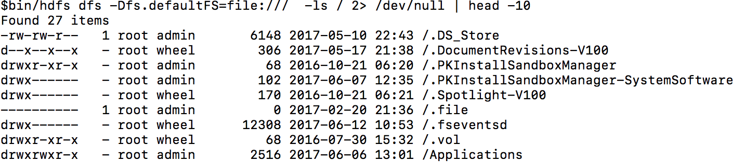
Specifing –D to alter configuration

Slide 8
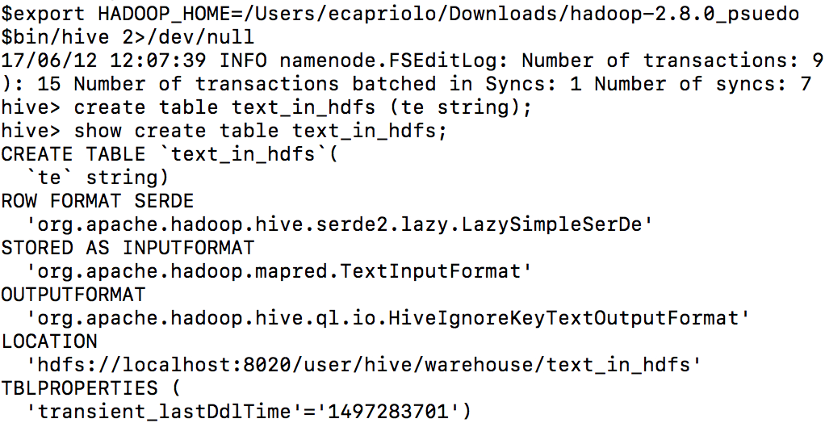

Slide 9
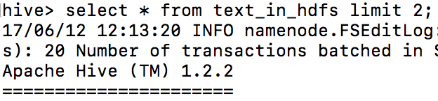

Slide 10
Migrating data using an INSERT INTO … SELECT query

Slide 11
Next Video
AdHoc analysis using streaming
Notes:
[Mandatory Slide]
Here the name of the next video needs to be mentioned. The narration as you guessed it would be just letting the viewer know exactly where we are at and what we’d be taking over next! ☺

